Slide 1
Emotional Music Player
Ruoyan Wu,Haotian Zhang,Sitong Liu

Slide 2
The inspiration
Music unquestionably affects our emotions. We tend to listen to music that reflects our mood. When we’re happy we may listen to upbeat music; when we’re sad we may listen to slower, moving songs; when we’re angry we may listen to darker music with heavy guitar, drums, and vocals that reflect our level of anger.
However there also exists a kind of reaction between our emotions and music. Many scientific studies prove that the music we listen do play a important role in affecting our emotions.

Slide 3
Working process
Use Google Cloud Vision
to get the data of the face
Compare and get the most strong emotion
Make Recommendation based on the upper analyze

Slide 4
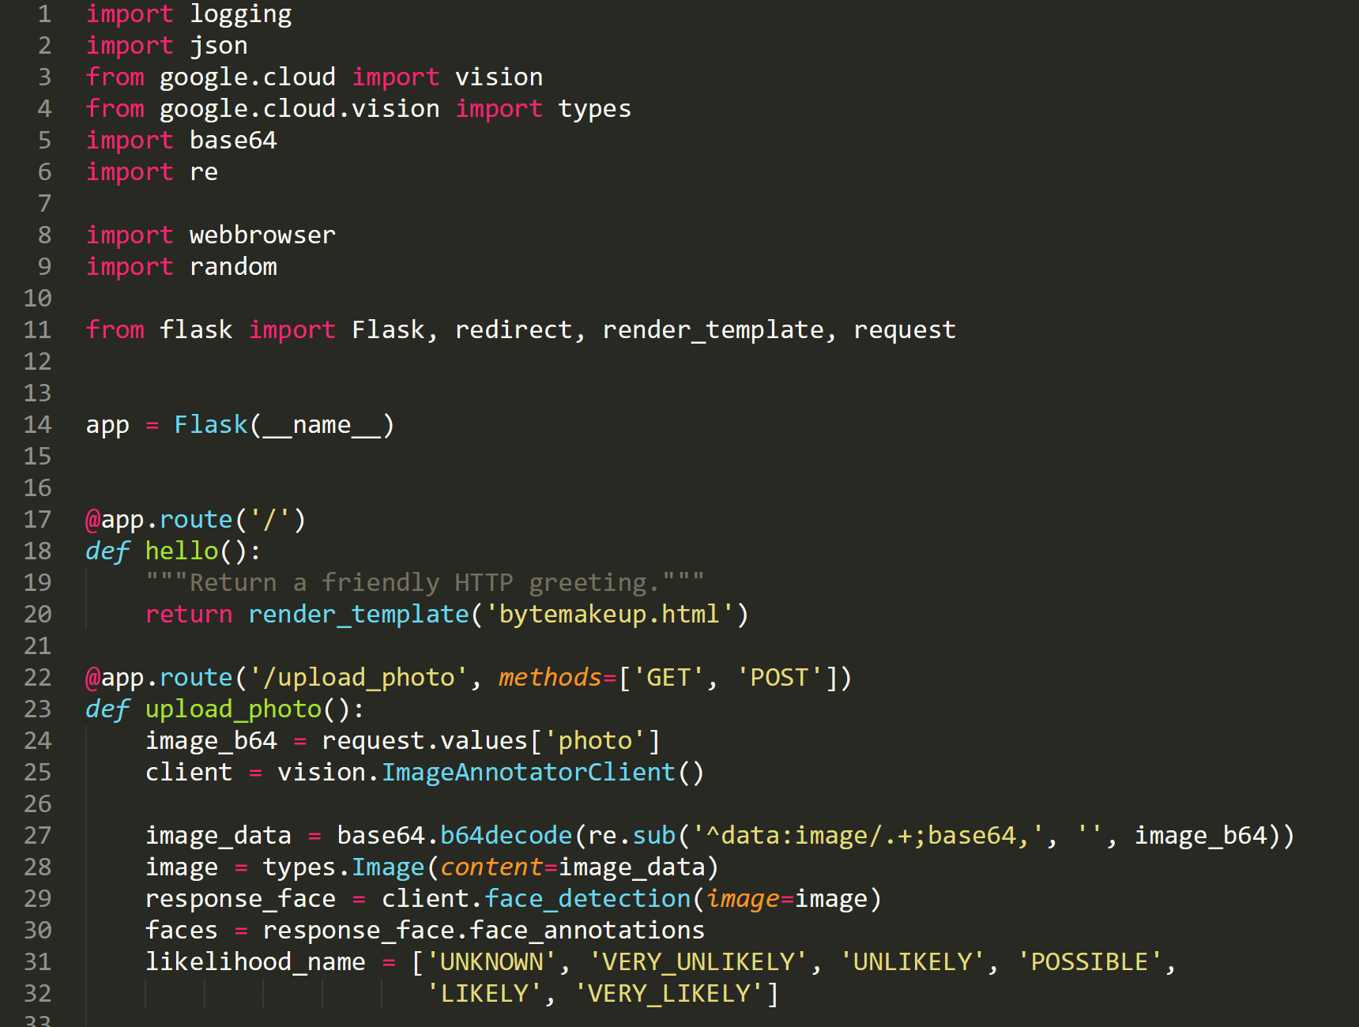
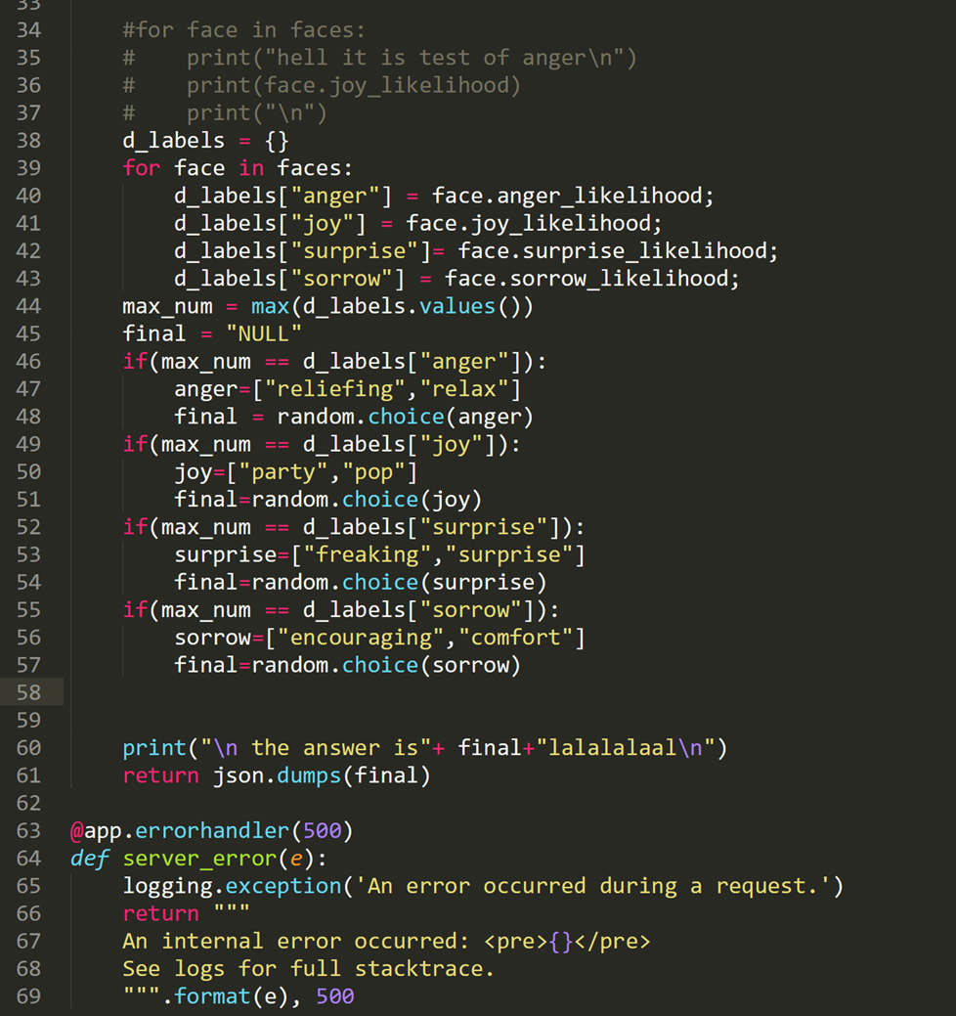
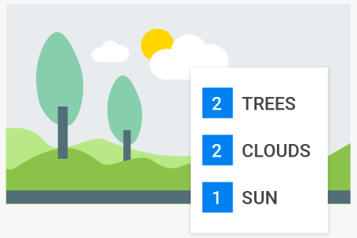
Usage of Google Cloud Vision
Cloud Vision API allows developers to easily integrate vision detection features within applications, including image labeling, face and landmark detection, optical character recognition (OCR), and tagging of explicit content.
Easily detect broad sets of objects in your images, from flowers, animals, or transportation to thousands of other object categories commonly found within images. Vision API improves over time as new concepts are introduced and accuracy is improved. With AutoML Vision, you can create custom models that highlight specific concepts from your images. This enables use cases ranging from categorizing product images to diagnosing diseases.

Slide 5
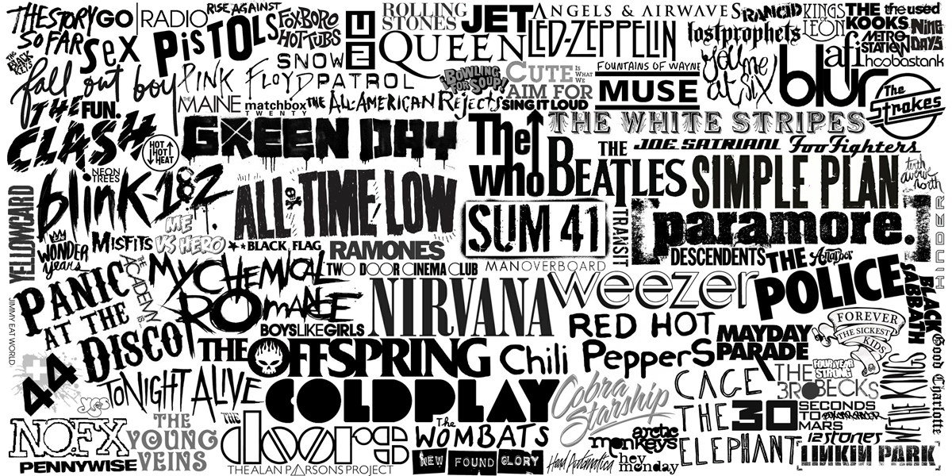
The implement
It can be a revolution of the music player app on the mobile platform. Even it is now very raw and simple for it uses youtube as the access of the music .This is a bright new way for costumers to try to get bright new experience from trying new albums and records.

Slide 6
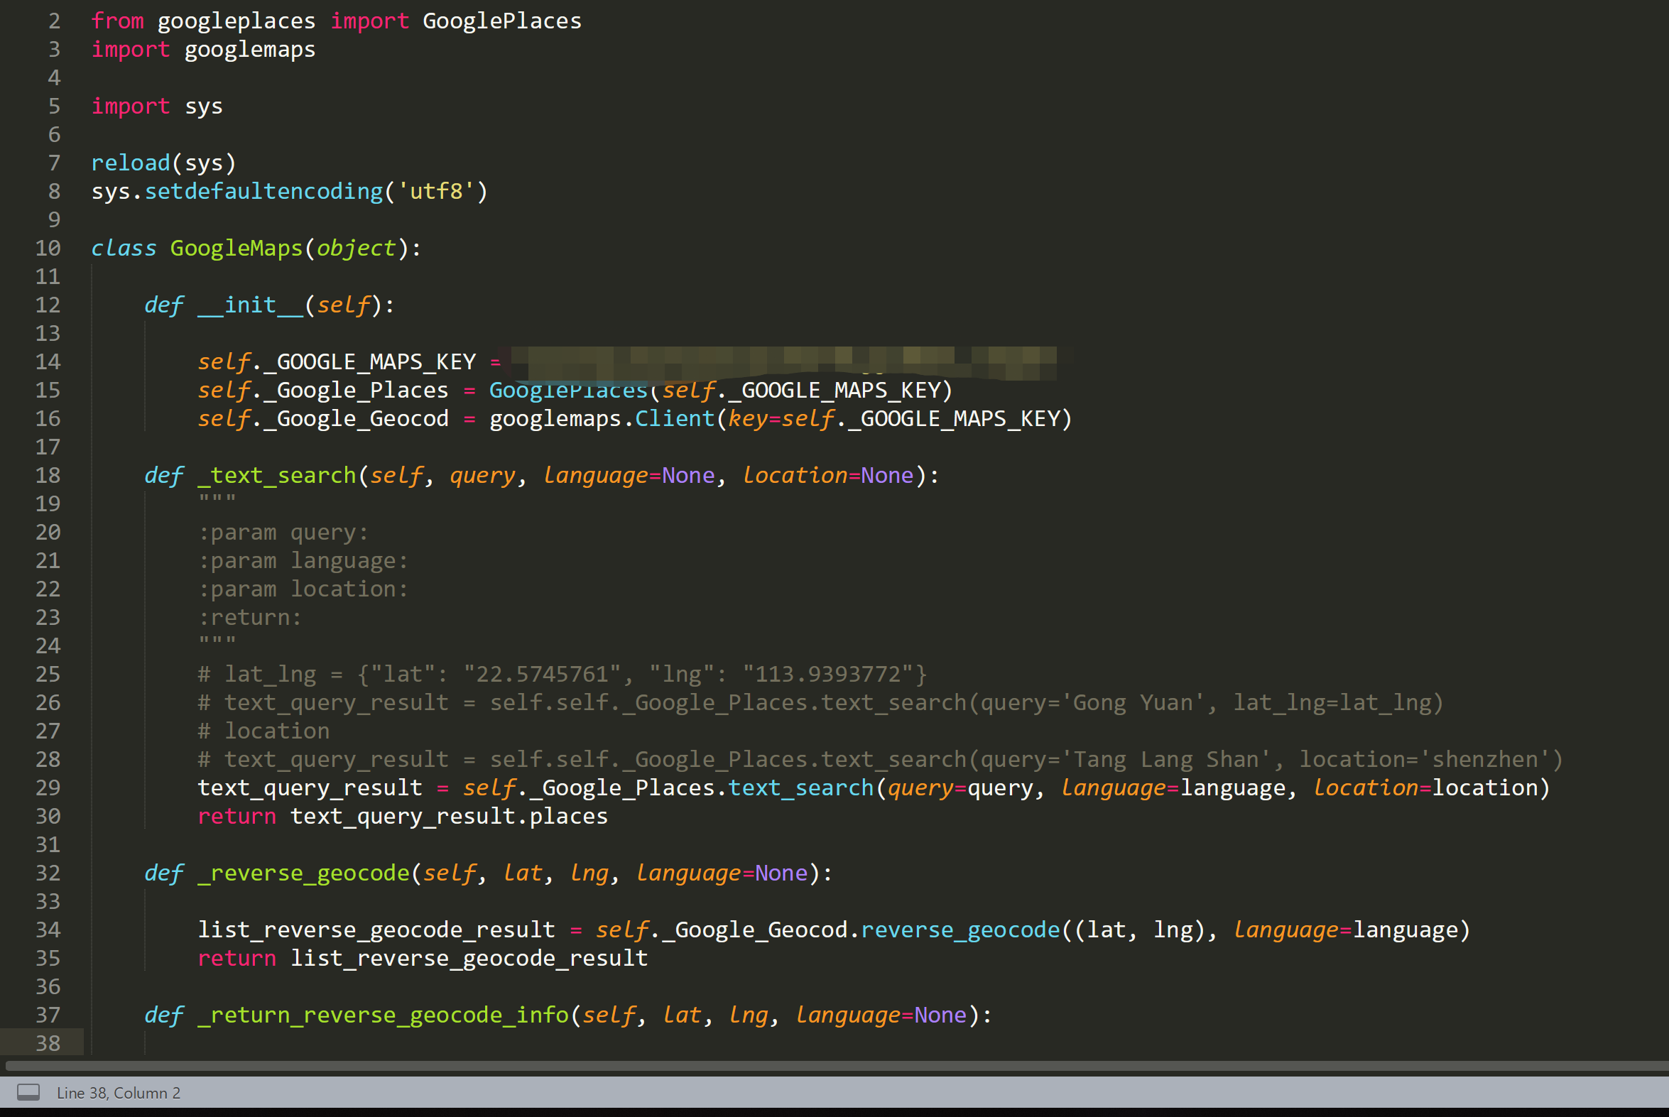
Further plan
We plan to use Google map API to achieve further functions. We can suggest the nearest café to someone who needs to relax and enjoy a peaceful afternoon. We can also encourage someone in their mood to enjoy a concert and share their understanding of music with someone near them.
We have also got a domain ‘ourbiss.com ‘and a server which is provided by Alicloud but not yet online.

Slide 7
Thanks for watching!
Why not change the world?

